Slide 1
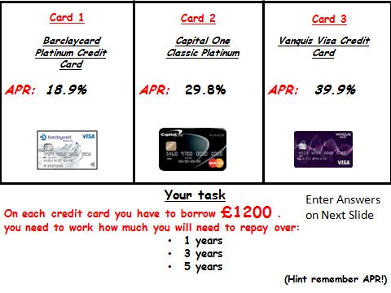

Slide 2
Card | APR % | 1 year | 3 years | 5 years
Card 1 | 18.9 | 1326 | 1581 | 1864
Card 2 | 29.8 | 1402 | 1829 | 2321
Card 3 | 39.9 | 1475 | 2076 | 2785
1 Year = 12 months 3 Years = 36 months 5 Years = 60 months
Credit Card Balance = £1200

